Slide 1
RETAIL SALES DASHBOARD
Monisha BN

Slide 2
Objective and Dataset
Objective: Analyze retail sales performance and profitability
Dataset: 200 rows of retail transactions
Fields: Order ID, Date, Region, Category, Sub-Category, Product, Sales, Quantity, Discount, Profit

Slide 3
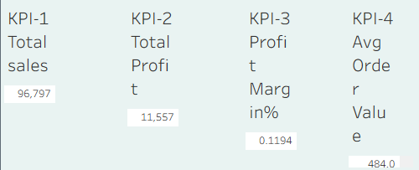
KPIs
Total Sales
Total Profit
Profit Margin
Average Order Value
YoY Sales Growth %

Slide 4
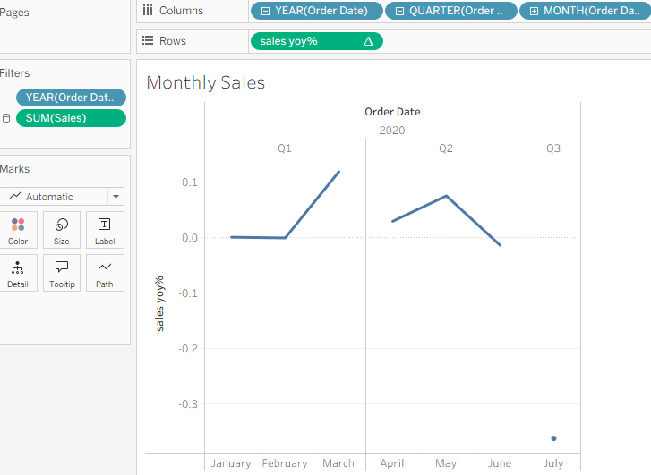
Sales and Trend Monthly Sales with 3-Month Moving Avg

Slide 5
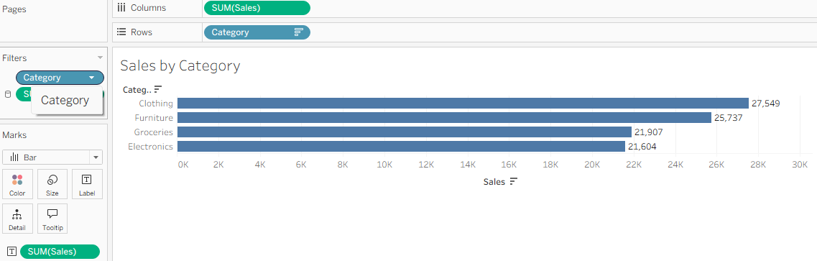
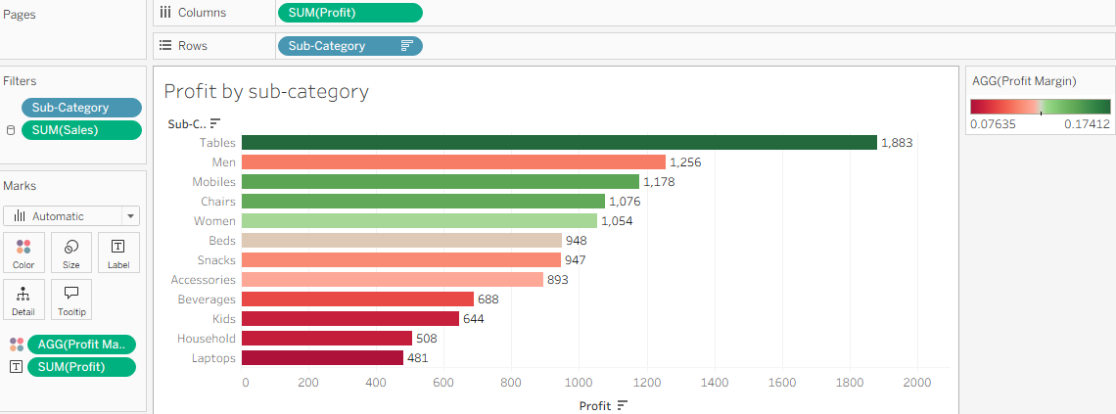
Categories & Sub-Categories Top categories by Sales Profit by Sub-Category

Slide 6
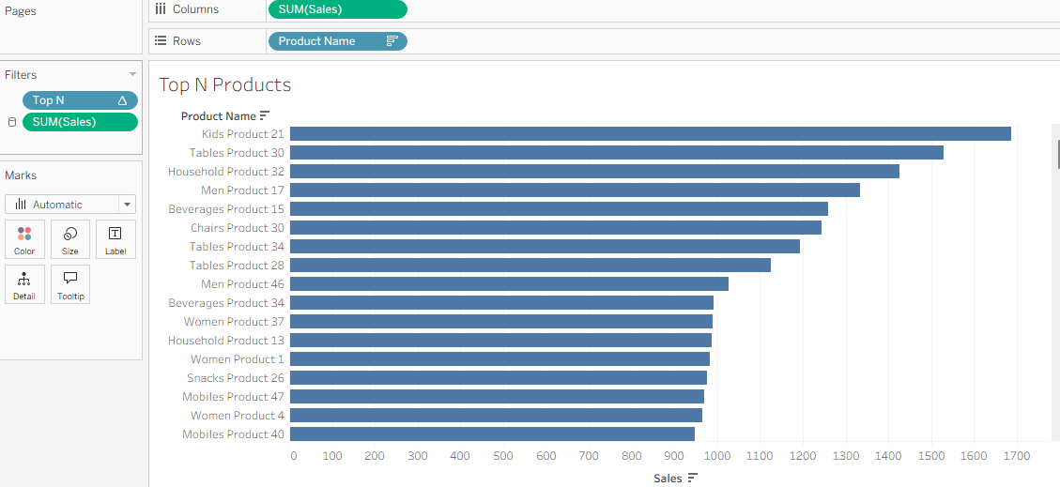
Top N Products

Slide 7
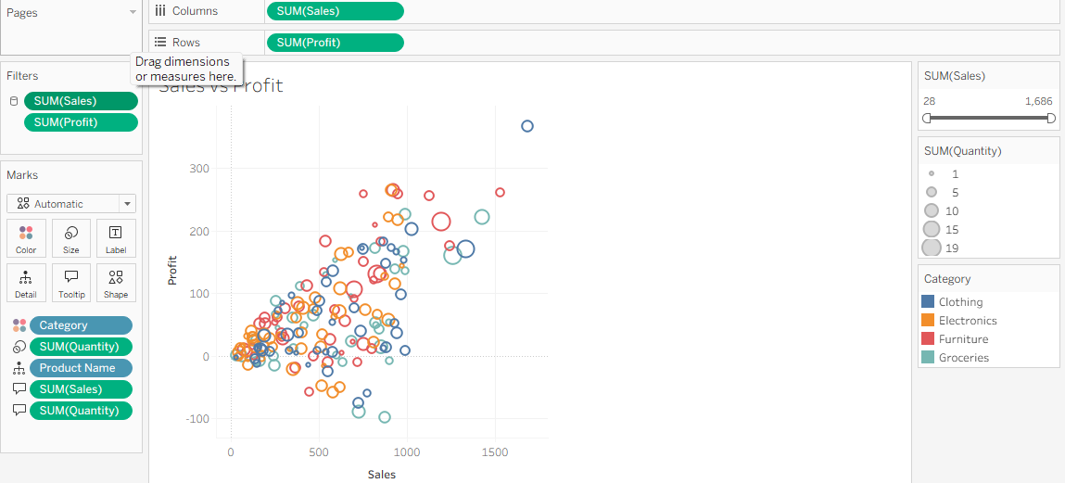
Scatter Plot
Sales vs Profit

Slide 8
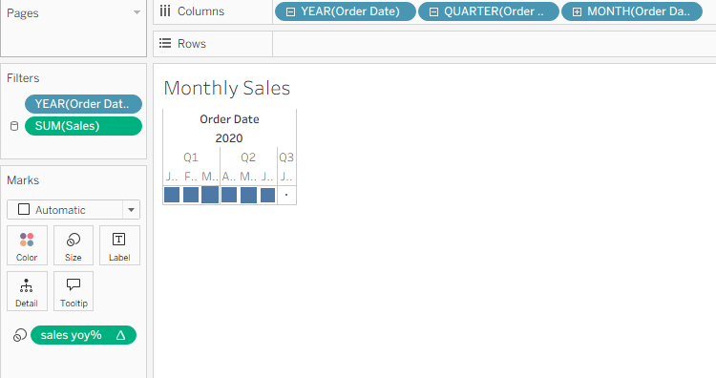
Heatmap & Table

Slide 9
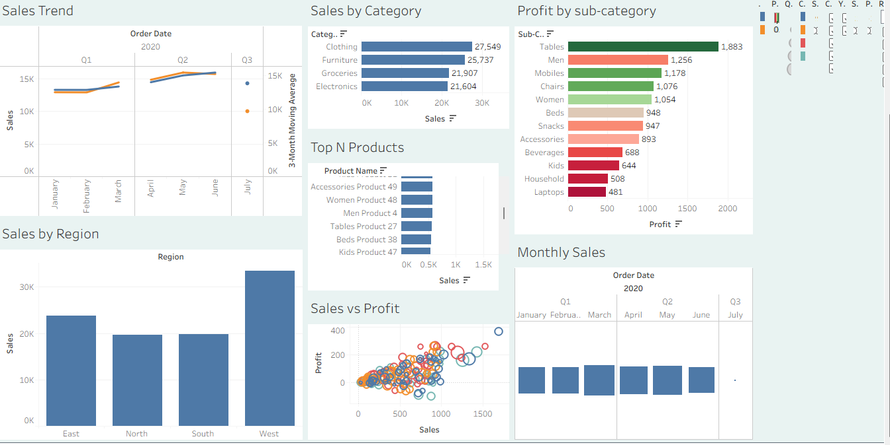
Dashboard Interactivity
Filters: Region, Category, Date
Parameters: Measure selector & Top N
Actions: Click → filter others, Hover → highlight

Slide 10
Key Insights
Electronics leads in sales, Clothing has better margins
Discounts reduce profit margin in some subcategories
Top 10 products generate ~60% of sales

